Slide 1
Modeling and Experiment Design
Prof. Mitchell
Computer Science Department
CSUS
Fall 2019

Slide 2
Introduction
0. Each student fills in info on passed-around SurveyClass form
1. Course syllabus (Handout: briefly discuss)
2. Prior to next class: First reading assignment: on course homePage, file named: DES_Wikipedia.html
(= Overview of the structure of a discrete event system simulator, and simulations)
A simulation develops a representation of a given existing system; purposes include:
- Model behavior about the system
- A system model enables Better understanding of the system
- Make reliable predictions about future system behavior {by conducting ‘WHAT IF’ studies}
Example: spread of an infectious disease:
an accurate simulation of that system can generate valuable predictions
Such a model predicts location and rate of disease spread
In this example, we could compare different strategies {everything policy from
Ignoring the disease to Quarantining} to deal with the disease …
Simulation is useful even for system S that does not yet exist, an S that is just a concept:
- simulation becomes the first tangible “prototype” of S to be built
- a simulation is usually much cheaper to build compared with a first physical build
Simulation as a problem-solving methodology
– if a problem has no Pencil/paper solution, and if no Mathematical solution formulas exist,
then the world turns to the only thing left = => simulation

Slide 3
Continuous and Discrete Simulation Systems
Def - given a system S, a simulation of S involves modeling, that is, representing:
> Objects (things/entities of S)
> Properties (each object has attributes & values & behaviors)
> Events (actions that change something about the state of S)
Many aspects of a simple single-barber (single-server) barberShop are seen in most service models
Objects – object types such as Customers and Barbers
Properties – customers have attributes such as hair color, haircut style, cash/credit payment, etc.
Events – things that change a system’s state, such as a customer arrival
Processes – activities/actions by objects (Ex: getting a haircut; greeting/“hello” upon arrival; . . .)
Modeling time – 2 treatments of the concept time (t) in simulation systems –
Temperature, fluid flow, etc. vary continuously over time, modeled by systems of differential equations
If state changes occur instantaneously in S, time advances in discrete increments, not continuously.
CSC148 uses only discrete time – meaning, things happen at discrete values of model time,
not wall-clock time, and time intervals where nothing happens are skipped over by simulation runtime
Such models are called discrete event simulation (DES) systems
2 common (but not the only) ways to implement a simulation are with executable programs written in
1) Some special-purpose simulation language exclusively used for simulation (Example: gpssW *)
2) An API extension to some general-purpose language (Examples: Java/Simjava, python/simpy *)
Historical note - simulation languages of the 1960s (Ex: gpssW, SIMULA67) were the first “object-oriented” programming languages; they originated many capabilities seen in “modern OO” systems
* Use gpss for First Part of course → Best suited for service models and server behavior
gpss – a mnemonic for: ‘General Purpose Simulation System’
gpss has Commercial and Student oriented versions; we will use the free student version
“gpssWorld” version (abbreviated as gpssW, or just gpss) ; it runs ONLY on Windows 10 back to XP
* Use simpy in Second course Part, python’s API called simpy → Better than gpss for modeling
interacting processes
Will use simpy3 (a recent simpy version) running on ECS virtual machine athena

Slide 4
Designing a first “ideal” simulation model of a one-barber barberShop
Customer flows and model Objectives
‘M’ stands for “model” Number of servers (1) Model type (queuing)
A single-server queuing model of a system S is denoted by M_{1Q}
Model structure consists of 1 server and 1 service wait queue
Assume that paths 1 and 2 are the only possible customer flows/paths through S
wait queue S boundary
customer C arrives 2: Customer arrives & barber busy server
1: Customer arrives & barber free c leaves S
Model state includes:
Def – n(t) the number (being served + waiting) of customers in M_{1Q} at model time t
(time is modeled as discrete clock ticks; n(t) changes only at t increments)
Some M_{1Q} model objectives:
> find some relationships between n(t) and t
> determine useful server statistics, such as:
* (% of time server is busy), usually called server utilization, aka “ρ”
* average(total customer duration in S), aka average “residence” time, aka “w”
* average server service duration “s”, per customer
2
xxx queue
c
server

Slide 5

gpss simulation language blocks; the general languages hierarchy
To SIMULATE the simple single-barber barberShop in gpss,
the two possible “paths” for each customer through the model must be represented
Each path involves a sequence of actions by a customer and the barber;
→ each action/behavior is implemented by one or more gpss blocks
(Note: gpss terminology – “entering” a block B means executing/doing the effects of B)
A given gpss block type can have SEVERAL effects, not just one or two effects = =>
gpss is classified as a Very High-Level Language (VHLL)
Language hierarchy: Assembly language - -> C - -> C#/Java/C++ - -> scripting languages - ->
spreadsheet - -> SQL - -> special-purpose simulation languages
(On average, each statement in the leftmost languages does relatively FEWER things compared with languages on the right)
Note – understanding precisely how each gpss block behaves is challenging when first using gpss; this is because of gpss’s VHLL characteristics (a block could have several effects)
Our first complete gpss simulation of barberShop (next slide) shows that gpss is a VHLL = =>
A complete simulation with useful results is only 7 lines of source code (can be reduced to 5 lines if we do
not want service wait queue statistics !!!)
{only run Start parameters and Termination condition (each a 1-liner) control statements are not counted}
A default report is dynamically generated , and can be displayed after a simulation
executes/pauses/aborts -- user does NOT need to code the report (= results stats) – it is built into gpss

Slide 6
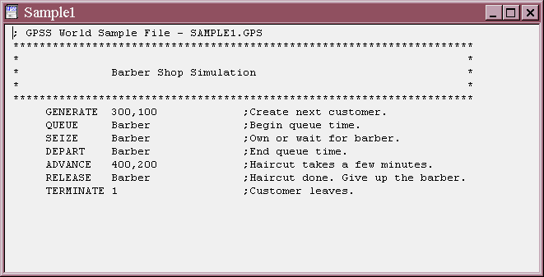
First gpss model implementation of M_{1Q}
gpssW runs on all Windows OS versions (NT or newer), but no common Unix/Linux systems.
Below is the first COMPLETE source code gpss simulation.
( In the source code above, a time unit (t.u.) is not documented with comment(s), but should be )
During analysis/design of a gpss model, a model-specific t.u. is specified, then documented in source;
In our barberShop, t.u. is 1 second; but in an astronomy simulation t.u. might be 1 century
The important point is: t.u. is problem-specific & user-defined & should appear in source code preamble.
Each customer enters the simulation by an effect of a GENERATE block GENERATE creates entities of one type, similar to a Java constructor or the python class __init__ function
This simulation does MORE THAN implement the 2 customer paths; it also gathers some stats
= > Characteristic of many DES languages, default stats are output with no need to program them
FACILITY ENTRIES UTIL. AVE. TIME AVAIL. < -- Part of the default report created during model
BARBER 1000 0.742 5.970 1 execution: ρ and s
jth arriving customer (we often denote as cj) gets a haircut = one specific service
Operands 300 and 100 of GENERATE specify parameters of a distribution of cj interarrival times;
these Operands are based on the t.u. value of 1, and notation for distribution types.
All time values are relative to the time unit defined in the source code documentation.

Slide 7
gpssW documentation
gpssW Downloads – go to csc148 website subdirectory named: gpssW (< = Case sensitive)
To get entire gpss runtime, copy all content of the above subdirectory to the platform where you want to use gpss (a folder on your laptop or a memory stick, etc.)
Documentation – the following 2 folders in the download constitute the gpssW documentation:
Reference Manual (documents all gpss blocks, statements, etc. used in CSC148)
World Tutorial Manual (a sequence of complete models, mostly not helpful for CSC148)
Important windows OS version Note – for windows 8 or newer:
The Help tab of gpss’s top menu is UNIMPLEMENTED (in fact, windows throws an error)
The workaround is manually navigating the (html formatted) GPSS World Reference Manual for documentation on all elements of gpss programming;
The first part of this course needs:
Chapter 7 documents each gpss block, and its Operands, if any
These blocks specify actions during a simulation (GENERATE, TERMINATE, SEIZE, etc.)
Chapter 6 documents commands for controlling
model configuration, initialization, execution, random number seeding, etc. (Start, RMULT, etc.)
==================================================
For Older versions of windows (such as windows 7) the gpss runtime has a built-in help interface:
The Help tab of main gpss window’s top menu is an indexed help system, used as follows:
- -> Help Topics then - -> (In Index context) {Select a Statement or Topic}- -> and then click: Display
Documentation Summary:
Older Windows ver., use built-in gpss Help menus
Newer Windows ver.: course website gpssW subdirectory, or your local copies of the 2 Manuals & use
html navigation

Slide 8
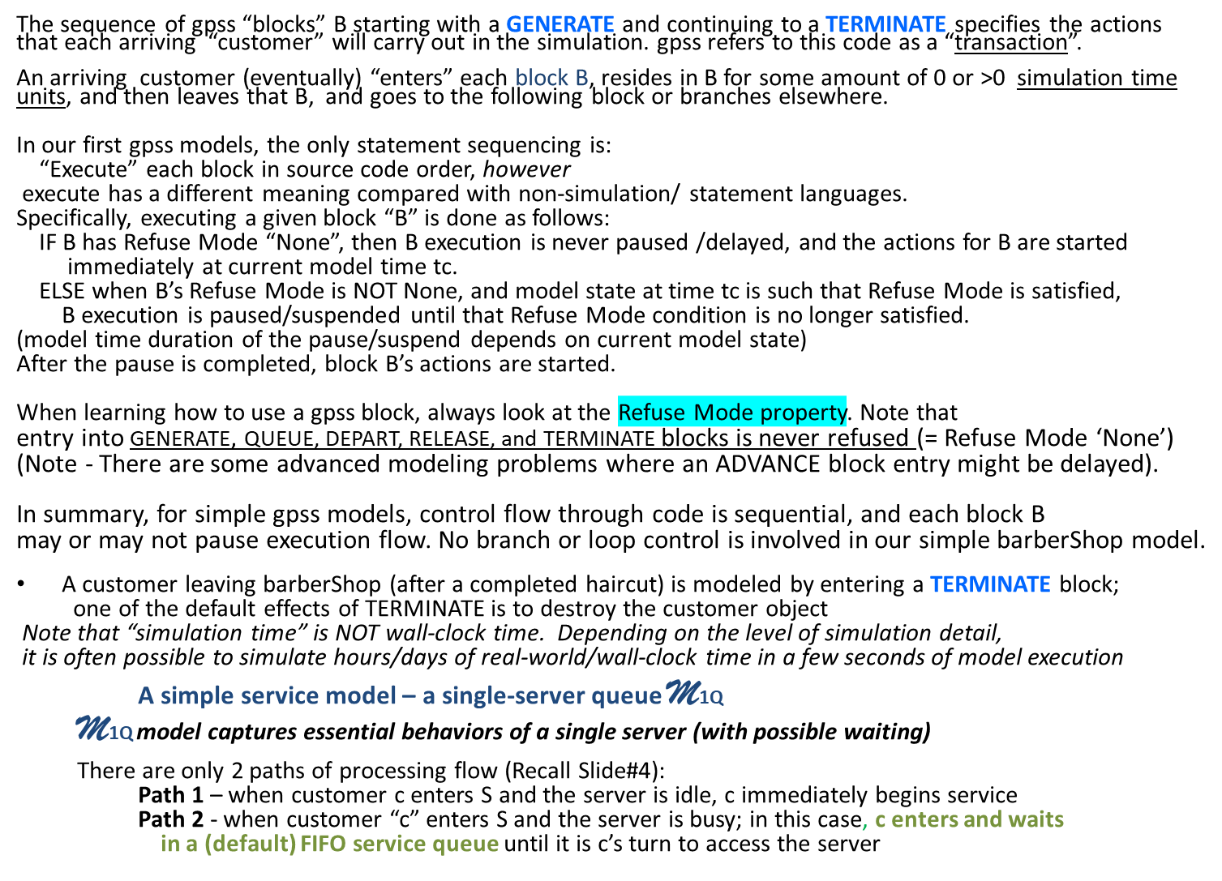
The basic gpss blocks execution model

Slide 9
Model assumptions for basic M_{1Q} models
M1Q ideal model assumptions – these are implemented by default in gpss
The server never fails (or gets tired or degrades service), and server operates continuously until a model run termination condition is met
2. Service processing is non pre-emptive: after a service starts, it continues, un-interrupted, to completion
(BUT, during a service, new arrivals can enter the barberShop, and wait for service)
3. Each service duration is > 0 (no instantaneous service)
4. No simultaneous customer arrivals (consequently, no simultaneous customer service finishes)
Customers cj never languish in S, nor disappear in S (that is, eventually get service and leave S) = a behavior we might refer to as: “conservation of customers”
An arrival, a service start (when SEIZE is not pausing c) AND the finish of a service (RELEASE block) are each, by default in gpss, treated as simple events, and each takes 0 model time.
Model design decisions determine: which system behaviors to include vs which behaviors to omit
(This is the most difficult/challenging part of designing more advanced simulations)
In more complex service models, ideal model assumptions will be dropped, depending on the system.
Examples of more realistic/detailed behavior, not in SAMPLE1.GPS:
If desired, the programmer could implement service startup with x t.u. > 0, to simulate such things as
1 a brief conversation about haircut style, the customer’s sick dog, or, anything else
2 joining/leaving the service wait queue could model > 0 time duration

Slide 10
SAMPLE1.GPS gpss blocks - Continued
There is only 1 barber (means one server) in S
Although the names are misleading, the QUEUE & DEPART blocks have a passive purpose in S;
as a pair, they gather traversal duration (i.e., residence stats) for the blocks they bracket/surround.
For each customer “c”, a SEIZE block simulates
1 ) waiting in a FIFO queue for the server when the server is busy AND ALSO
2) c beginning a service when it is c’s turn to use the server (whether c waited or not)
{ therefore, SEIZE has a possible suspend effect for c, depending on queue content as c arrives;
thus SEIZE blocks have a “Refuse mode” }
When the server is busy, c waits in the FIFO queue (in this situation, the SEIZE block is delaying the
“progress” of c); c remains delayed “AT but NOT IN the SEIZE block” for some amount of time > 0
As soon as it is c’s turn for service, c progresses to the next block following SEIZE;
as previously noted, service for c starts immediately, and c “owns” the server (gpss terminology) .
The DEPART block is passed through immediately (Refuse Mode is None) and a side-effect is that gpss
automatically calculates c’s service wait duration
Equivalently, c’s sercice wait duration is the amount of model time take by c to proceed through these
QUEUE, SEIZE, and DEPART blocks.
Review – c passes through each QUEUE or DEPART block transparently, and each uses 0 t.u.
An ADVANCE block is the simplest way to represent doing a haircut and haircut duration
The effect of ADVANCE is several things:
1. suspend the “current” customer c being served “in” the ADVANCE block;
2. gpss automatically re-schedules c to resume at time (startCservice + (service time for c)) = tcf
(c will remain “in” this ADVANCE block for the duration of c’s barber service)
3. gpss runtime schduler determines next action to perform in the simulation at time t >= startCservice
IMPORTANT Note: Entry into an ADVANCE does NOT increment current model time !!!
(this is a point of confusion for many new to gpss)
At any model time t, gpss maintains the list CEC (Current Event Chain) of actions to happen at time t.
During c’s service, c will be represented in the internal-to-gpss FEC from time haircut starts at
startCservice until time tcf
At any model time t, gpss maintains a list FEC (Future Event Chain) having an entry for each “future” event relative to (that is, greater than) time t.

Slide 11
SAMPLE1.GPS gpss blocks - Continued
Customer waiting is the first example of gpss simulating parallelism/concurrency –
The first model time this happens is when some c is served in time interval [now, tcf], AND at some time t’ in [startCservice, tcf), another c’ enters S and enters all blocks until suspended at SEIZE.
With our ideal assumptions, c’ proceeds past the QUEUE block, but is immediately suspended before entering the SEIZE block
= > Even though you do not need to code a “queue data structure” in the model, gpss is, in effect implementing an internal FIFO queue representation for waiting customers.
= > The internal wait queue associated with a SEIZE block does customer insert/delete automatically
? When does c’ start service ? (Calculated auto. By gpss) Ans: tcf – (c’ arrival time)
(Note also, that iteratively, another customer c’’ might arrive in S before c service is complete; in this case, for some interval of time, 2 customers would be in the service wait queue)
Futures note – DES systems vary in how user models express service waiting:
gpss, by default, internally implements FIFO service wait queuing – this eliminates the need for coding queuing; however, non-FIFO queueing would need to be coded explicitly
Python simpy does not automate resource wait queuing. Any and all queueing must be explicitly coded in each simulation; as such, simpy is more general-purpose, requiring the model coder to code every aspect of queuing, including the data structures and their methods.
At model time tcf (recall def. above) , one of the actions processed by gpss is:
customer c leaves block ADVANCE 400, 200 and then enters and immediately leaves the
RELEASE block. After RELEASE block processing, the server has finished with c
and the server is now immediately ready to process other waiting customers (if any).
We said “ready” rather than “available” because available has a technical meaning for a gpss
server (having to do with server failure/recovery – studied later)
c will move on to the block following RELEASE, namely the TERMINATE.
Note - the RELEASE consumes 0 model time, thus, “finishing” a haircut takes 0 model time
(review of an ideal model assumption noted earlier)

Slide 12
Starting and Stopping a model run
Each time a customer finishes model execution by entering and immediately leaving
(with 0 model time elapsed) a TERMINATE 1 block; tc is decremented by 1.
(tc is an internal gpss variable that tracks, by a counter, when a customer leaves the system,
AND the customer object is automatically destroyed – no need for model code to “manage objects
If a TERMINATE block has no A Operand, the customer leaves the model, but tc is unchanged
==============================================================
The simplest way to launch/start a model execution is with gpss main menu Command:
START tc { Default tc value is 1; Example: to model 250 haircuts, we issue: start 250 }
where “tc” stands for model execution’s initial ” “termination count”
A model execution completes when a TERMINATE block entry (by ANY transaction) decrements tc to 0.
When tc becomes 0, the model run halts, and
a default x.rpt file (= a standard statistics summary Report) is created & displayed, and
a final x.sim file (= a model run events trace) is completed
(During model execution, file x.sim is continually updated & displayed in a different window from the source model file)
With the first gpssW source code you see, lack of “I/O” statements is probably puzzling
But each gpss model run silently & incrementally generates an x.rpt
Files x.rpt and x.sim are written as a simulation executes, and both files
are accessible even if a model run aborts (useful for debugging) }

Slide 13
gpss terminology in simulation models
From the gpssWorld documentation -- How a gpss simulation executes:
Blocks and Transactions
GPSS simulations consist of a network of "Blocks", which represent actions or delays to be encountered by a set of "Transactions", which "enter" one Block, then the next. The whole simulation is simply a sequence of one Transaction entering one or more Blocks, then another Transaction, and so on. . . .”
Explanation of each underlined section of the above -
“network of Blocks” – the gpss source code blocks of a gpss model
“actions or delays” – each gpss block that is executed (aka “entered” as gpss says it)
during a model run can cause an action or event or some kind of model state change;
The gpss term “delay” refers to a block for which an entity x entering that block is suspended by gpss from further execution until resuming at some future time; the delay simulates an activity by x.
“transaction” (tr), not related to database or computer peripheral bus, etc. transaction construct.
A tr refers to a sequence of gpss blocks: GENERATE … other blocks … TERMINATE x
For example, SAMPLE1.GPS has one transaction type modeling the actions of a customer; on the other hand, the barber is very “passive” (actions represented only by SEIZE, RELEASE)
In M1Q a GENERATE block creates customer arrivals;
The blocks sequentially following a GENERATE model behaviors/actions of each customer.
In summary: each tr is a true model object type instance; a block corresponds to a method in modern OO.

Slide 14
Model stability
In our first model, SAMPLE1.GPS, GENERATE and ADVANCE block Operands determine model stability (stability means: eventually settling into a state where long-term state values converge to specific limits.
{ An unstable model is as serious as an infinite loop construct in programming languages }
Specifically, in most applications, long-term values such as avg(c residence time) and avg(queue length) must be bounded, rather than increasing indefinitely.
Stability can be expressed mathematically for a system as simple as M1Q . Stability requires:
(rate of customer service) > (rate of customer arrivals) (1)
The intuitive idea is that when customers arrive faster than haircuts can be done, then wait time for a haircut (=average service wait time) increases without bound as a model continues to run
GENERATE 300,100 and ADVANCE 400,200 specify:
Mean time between customer arrivals (aka interarrival time) = 300 seconds = 5 minutes
Mean time per haircut = 400 seconds = 6.67 minutes
(Converting time to minutes makes these values easier to work with)
Rate of customer arrivals = 1 / (mean wait between customer arrivals ) = 1 / 5 = 0.2 arrivals/minute
Rate of haircut = 1 / (mean haircut duration) = 1 / 6.67 = approx. 0.15 haircuts/minute
Inequality (1) does not hold; SAMPLE1.GPS is unstable, because of Operands 300 and 400 = =>
if this model is run long enough, any pre-specified queue length will be exceeded
Mathematicians/Engineers have dealt w. stability for > 2 centuries: many variables & internal randomness
Physical systems – you buy 2 new tires for your vehicle front end … ? done with spending $ ?
- -> Modeling of input, such as GENERATE and ADVANCE Operands is a significant part of design of any
service-oriented gpss simulation. Analyzing run results is also a major topic for simulation systems.
In many simulation textbooks (30% !!!) involve ways that model data relates to simulation.

Slide 15
Example unstable M_{1Q} model run
Example M_{1Q} run for an unstable system:
It shows a gpss report section showing a server getting hopelessly behind
(caused by: (c arrival rate) > (c service rate)
Def – in gpss, a single-server is referred to / called a facility. Its name is global in the model = => the name can be referenced within any tr
Selected sections of Report file:
Overall model statistics:
START_TIME END_TIME BLOCKS FACILITIES STORAGES FREE_MEMORY
0 6317 10 1 0 1808
Queuing statistics for a QUEUE/DEPART section:
BLOCK_TYPE ENTRY_COUNT CURRENT_COUNT RETRY
QUEUE 787 152 0
Server statistics:
FACILITY ENTRIES UTIL. AVE._TIME AVAILABLE OWNER PEND INTER RETRY DELAY
BARBER 635 0.998 9.93 1 635 0 0 0 152
Notes:
A low FREE_MEMORY value is usually not the first indicator of an unstable model.
Rather, a UTIL. value close to 1 and/or QUEUE_COUNT (in the hundreds) usually occurs early-on in execution of an unstable model
Memory exhaustion will occur soon
Excessive queue contents
Excessive facility utilization

Slide 16
Default formatted Report output from a gpssW single-barber model run
gpss World Simulation Report - b1_jan06.1.1
Wednesday, January 6, 2018 10:22:02
START TIME END TIME BLOCKS FACILITIES STORAGES ← Report header line
0.000 8040.997 5 1 0
NAME VALUE ← Symbol table
BARBER 10000.000
LABEL LOC BLOCK TYPE ENTRY COUNT CURRENT COUNT RETRY ← Model blocks – ENTRY COUNT is total number of tr
1 GENERATE 1000 0 0 (of any type) that entered the block during the run
2 SEIZE 1000 0 0
3 ADVANCE 1000 0 0
4 RELEASE 1000 0 0
5 TERMINATE 1000 0 0
FACILITY ENTRIES UTIL. AVE. TIME AVAIL. OWNER PEND INTER RETRY DELAY
BARBER 1000 0.742 5.970 1 0 0 0 0 0
This UTIL. value cannot possibly be from 1000 haircuts in the original SAMPLE1.GPS – Why ?
FEC XN PRI BDT ASSEM CURRENT NEXT PARAMETER VALUE
1001 0 8041.266 1001 0 1
--------------------------------------------------------------------------------------------------------------------------
Report Item Explanations
Report header line
START TIME – Model start time (usually 0; “warm up” techniques covered later) (0.000)
END TIME – Clock value when run finishes (8040.997)
BLOCKS – Number of gpss blocks in source program (5)
FACILITIES – Number of identified/labeled single-servers, aka facilities (1)
Blocks trace section
LABEL - Block label (if any)
LOC – Relative block number in source program
BLOCK TYPE – Type of gpss language block
ENTRY COUNT – Number of tr (of any type) that entered this block during the run
CURRENT COUNT – Number of tr in/occupying this block at current time
+ FACILITY – For each facility in a model, stat. summary; (more on next slide)
+ FEC XN – Future Event Chain tr number; a line for each event scheduled at someTime > currentTime
Display FEC using: Window → Simulation Snapshot → FEC Snapshot

Slide 17
Default formatted Report info for each gpss facility entity
Each facility in a simulation model has the following statistics, all shown in one line of the standard gpssW Report:
FACILITY – Name/Label of a particular facility in model
ENTRIES – Total number of tr that have entered the SEIZE block for this facility during the run
UTIL. – Average utilization of this facility, or % of time this server was busy during the run: expressed as a fraction (0.0<=UTIL.<=1.0) or as a % Example: UTIL. 0.742 or 74.2%
AVE. TIME – Average service duration over all transactions that used
this server (does NOT include service wait time)
AVAILABLE - When =1, facility is “up”, and when=0, is “down”;
when=0, server simulates a failure state (cannot be used)
{ We simulate service failures later in course }
OWNER - Transaction (number) of current owner/user of facility
If 0, no transaction currently is using the server
+ 4 others - Not covered in this course
------------------------------------------------------------------------
Notes:
1) We need more sophisticated reports later in the course.
The default gpss report will automatically expand as more model entity types are added.
2) Special-purpose simulators such as gpss have built-in reporting that is adequate for many purposes (substantially reduces need for modelers to spend time coding reports;
Not – simple models almost never need the developer to code report logic, but, in complex models, special report coding will be needed)

Slide 18
Some interacting skeleton tr flows
gpss models can have several different block grouping patterns . The most common one is:
1: GENERATE Operands
some blocks <- - No TERMINATE or GENERATE
TERMINATE x
2: However, is not GENERATE Operands
allowed. some blocks (not including GENERATE, nor TERMINATE or a branch) <- - No TERMINATE or GENERATE or branching (2) Demo
GENERATE Operands <- - Illegal to step into a GENERATE block . . .
On the other hand, a blocking structure like the following is legal. It is useful for >=2
tr that have different blocks at their start but have common blocks at their end.
3: GENERATE Operands GENERATE Operands
.blocks <- - N some blocks <- - No TERMINATE or GENERATE o TERMIN. . .ENERATE or branching here
branches past next nested GENERATE/TERMINATE block sequence
GENERATE Operands
TERMINATE x
. . .
TERMINATE x GENERATE Operands (3)
some blocks <- - No TERMINATE or GENERATE or branching here
TERM1anch past label GEN3 GEN3 GENERATE
. . .
Each block sequence: GENERATE … TERMINATE represents the actions of a tr whose occurrences arrive in S according to its GENERATE distribution (and independently of
other tr types).
There can be any number of non-overlapping trs of types 1 and 3 above.

Slide 19
Some interacting skeleton tr flows - Continued
multi_gen_common_terminate.gps Demos multiple GENERATES with common TERMINATE
* Usage: Execute with START 2
GEN1 generate 5 ; Arrival every 5 T.U. of 1st tr type “GEN1”
transfer ,fin_tr ; Branch to common terminate block
GEN2 generate 8 ; Arrival every 8 t.u. of 2nd tr type “GEN2”
fin_tr terminate 1 ; EXIT The System
Summary of some of the Result default Report file for the above model (.rpt file)
START TIME END TIME BLOCKS FACILITIES STORAGES
0.000 8.000 4 0 0 <- - 4 model blocks, 0 single-servers (no SEIZE blocks)
When the first GEN2 tr terminates, the model run terminates.
Virtual program addresses (= relative source code locations) of labels, sorted by Name:
NAME VALUE
FIN_TR 4.000
GEN1 1.000
GEN2 3.000
Block entry trace counts
LABEL LOC BLOCK TYPE ENTRY COUNT CURRENT COUNT RETRY
GEN1 1 GENERATE 1 0 0
2 TRANSFER 1 0 0
GEN2 3 GENERATE 1 0 0
FIN_TR 4 TERMINATE 2 0 0
Future Scheduling chain contents (Display using: Widow - -> Simulation Snapshot - -> FEC Snapshot)
FEC XN PRI BDT ASSEM CURRENT NEXT PARAMETER VALUE
3 0 10.000 3 0 1 <- - Each transaction type has an arrival
4 0 16.000 4 0 3 scheduled for a future time

Slide 20
Model execution tracing (and display in .sim file)
During model execution an events “trace” file named x.sim is automatically displayed in a separate window
There are two formats for x.sim.
First trace format - when the model starts/resumes from a suspended state, and you want to trace the model, one block entry at a time. For example, if an entire model run is executed this way, beginning with the start of the run, then the trace, one block entry at-a-time looks like:
06/03/14 20:59:40 Model Translation Begun.
06/03/14 20:59:40 Ready.
06/03/14 21:00:00 STEP 1
06/03/14 21:00:00 Simulation in Progress.
06/03/14 21:00:00 Halt. XN: 1. Block 2 Next.
06/03/14 21:00:00 Clock:5.000000. Next: TRANSFER. Line 5.
06/03/14 21:00:00 transfer ,fin_tr
06/03/14 21:00:03 STEP 1
06/03/14 21:00:03 Simulation in Progress.
06/03/14 21:00:03 Halt. XN: 1. Block 4 Next.
06/03/14 21:00:03 Clock:5.000000. Next: TERMINATE. Line 7.
06/03/14 21:00:03 fin_tr terminate 1
06/03/14 21:00:04 STEP 1
06/03/14 21:00:04 Simulation in Progress.
06/03/14 21:00:04 Halt. XN: 2. Block 3 Next.
06/03/14 21:00:04 Clock:8.000000. Next: GENERATE. Line 6.
06/03/14 21:00:04 GEN2 generate 8
06/03/14 21:00:05 STEP 1
Note: a TRACE/UNTRACE block pair within one tr automates tracing between these blocks

Slide 21
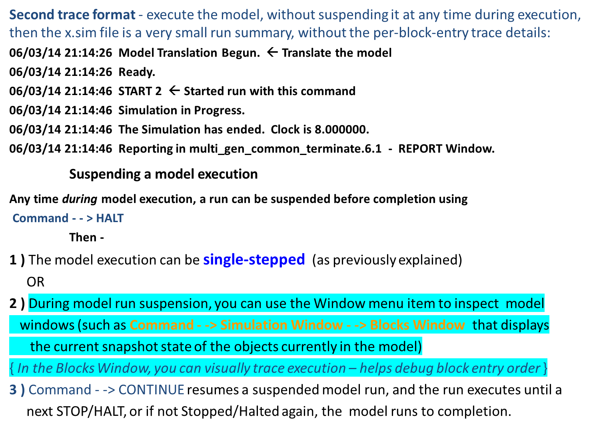
Model execution tracing (.sim file)

Slide 22
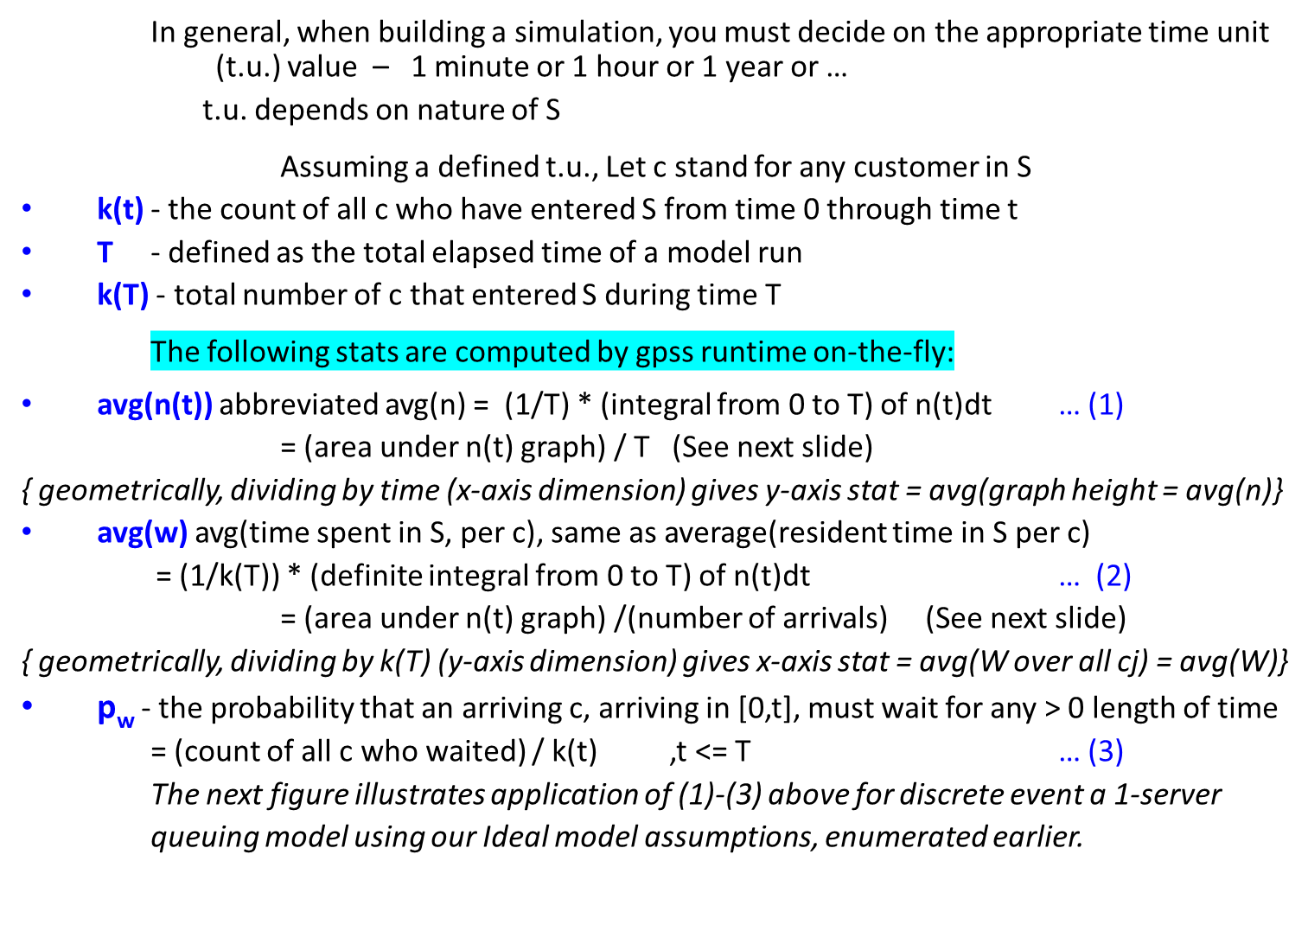
Computing Result Statistics for M_{1Q}

Slide 23
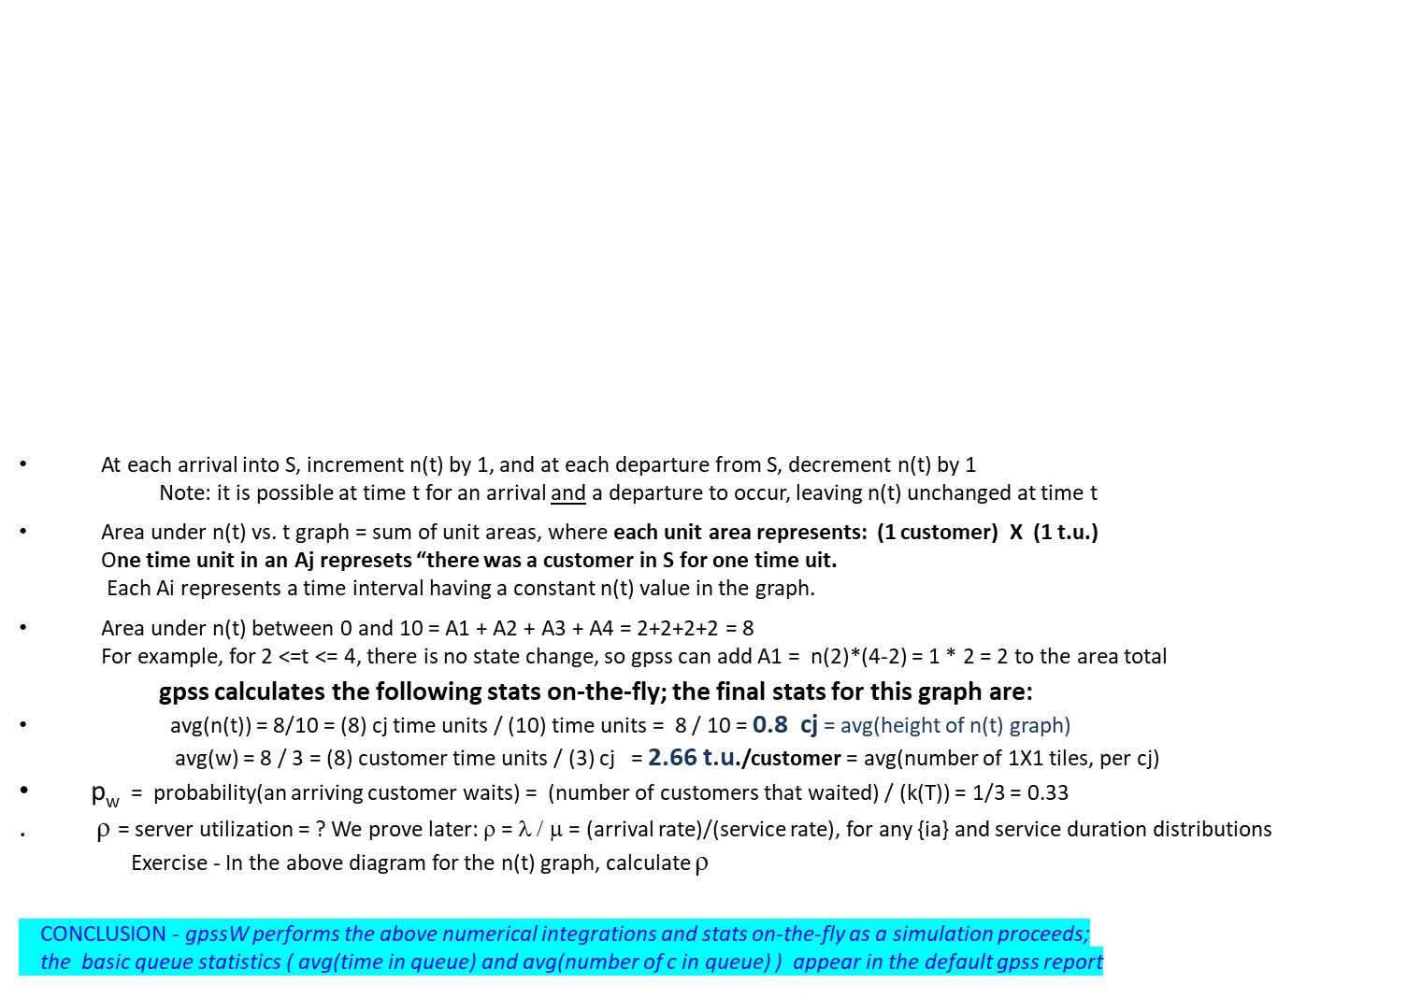
Some Result statistics for M_{1Q} cont’d
Figure – n(t) vs. t graph
n(t)
A3
A1
A2
A4
0 2 4 5 7 8 10 t

Slide 24
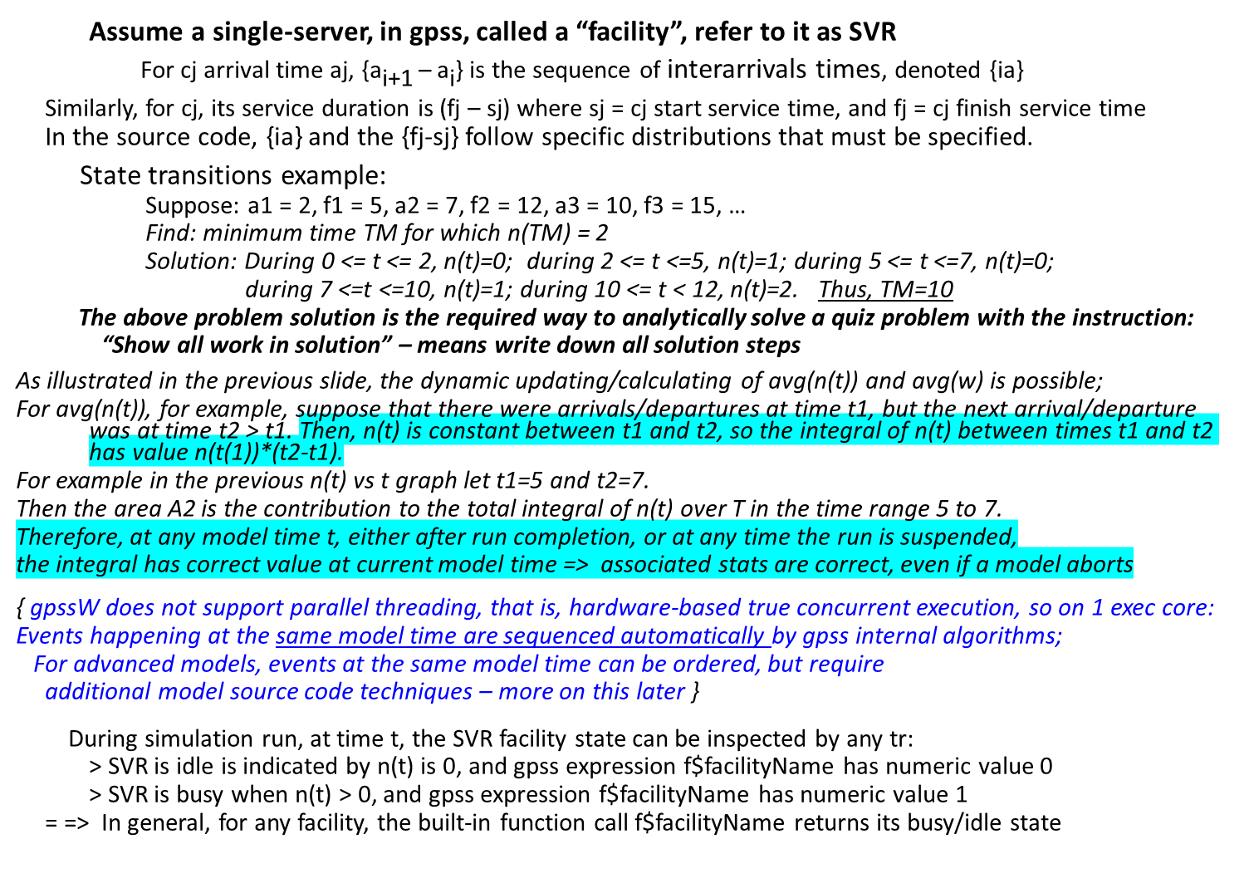
State transitions, Event scheduling and Statistics in M_{1Q}

Slide 25
Components of any system discrete-event system (DES) model
Six components of any M_{S} – with illustration from a system S of type M_{1Q}
1. Clock – clock tick unit meaning is user-defined, per model; defined ONLY IN SOURCE DOCUMENTATION
gpss does NOT need to calculate each clock tick; ticks are skipped (and time jumps) in intervals having no events
2. Objects – the things/entitiy types the model represents (customers, servers, etc.)
3. Events – below are “simple” event type examples; they happen instantly in models looked at so far
e1 = customer c arrives in S, or some kind of object is created
e2 = some c starts service
e3 = some c finishes service and immediately leaves S (first M_{1Q} implementation treats finish service & leave S as
one event)
“Complex” events, called processes/activities … (depending on the DES) take place in a > 0 time interval;
Example: cj service
4. State variables to represent S state; M_{1Q}, has a very small state space because S is simple
n(t) = ( count(customers waiting) + count(customers being served) ) at time t
k(t) = count of c that have entered S between times 0 and t inclusive
{ assigns the next positive int to each generated tr – referenced in code as XN1, XN2, etc. }
5. Conditions Cond(1): n(t)=0; Cond(2): n(t)>0 {these conditions effect SEIZE behavior}
6. Delays
. It is model-specific concerning the amount of model time take by a given event ej
. The details of what an ej does are also specific to a tr type
Example – Auto/Truck repair shop: Assume car & truck are different tr types
Case 1 – 2014 Dodge Caravan in good condition comes in for an oil change vs.
Case 2 – 1987 Ford Bronco died in street & being pushed in (front-end control arm broke)
= => Case 1 and Case 2 arrival processing might differ widely: near 0 and 15 minutes, respectively
In advanced models for any S, the Analysis & Design of a simulation become difficult -
Typical of issues for any larger scale software development, whether simulation or ordinary programming
1) what system behavior is an event type
2) all distinct object types; in gpss, this is defining (with GENERATE) the different tr types
3) properly relating state variables and conditions with model variable values and time delays
4) synchronizing (delaying/resuming) events/actions that affect entity actions
5) statistics calculations

Slide 26
Different kinds of {ia} and service distributions; more on model assumptions
Some {ia} distribution choices -
Constant: Although simple, it can be useful. For example, in the barberShop model, if 1 t.u. = 1 minute,
we can add a once-per-week barber supplies process. If supplies happened every Sunday of a 7-day workweek Monday through Sunday, supplies happen every 7th day. Simulate this by
GENERATE 7*24*60
The A operand was left non-symbolically to show the constant periodic supplies process at the end of every 7 days, expressed in minutes. (More properly in gpss, code value 10080 symbolically, using an EQU)
Uniform: In model SAMPLE1.GPS, the {ia} distribution is uniform and its mean is the value of the first Operand. The second operand is max. deviation from the mean.
Uniformly distributed satisfies: (mean – deviation) <= ia <= (mean + deviation), so for SAMPLE1.GPS,
each ia term value satisfies 200 <= ia <= 400, and each ia value is equally likely.
Exponential: each inter-arrival value ai satisfies 0 < ia < ∞, and the ia are highly variable.
Successive arrival times are not affected/influenced by any previous arrival time(s) - More on this soon
An example of removing an ideal model M_{1Q} assumption
In models so far, a transition such a server SVR is busy to free uses no model time elapsed time.
Busy-to-doneWithcj non-zero transition time could be implemented by successive ADVANCEs with:
SEIZE svr
ADVANCE serviceDuration distribution parameters
ADVANCE busyToFreeTransitionDuration distribution parameters
RELEASE svr
Ideal models simplify introduction to simulation modeling. By contrast, removing an ideal assumption usually results in a more complex model and more detailed simulation coding.

Slide 27
gpss implementation of M_{1Q} , continued; block Refuse Mode
ADVANCE – simulate the amount of model time for service duration (or some other kind of delay) for this transaction;
Operand A specifies mean duration; use ADVANCE to simulate elapsed time “el_t” of any model action
This is accomplished in ADVANCE block processing by
1) suspending the transaction and 2) re-scheduling this tr resume at time = (current time + el_t)
REVIEW: very important: entering an ADVANCE does NOT affect the current model clock value !!!
RELEASE - A transaction entering such a block relinquishes (means finishes using) the server identified
by the A Operand. By default, there is 0 duration associated with this kind of block
Note: each RELEASE must have a corresponding SEIZE w same A operand (otherwise, runtime error)
TERMINATE 1 – a transaction entering this kind of block will be destroyed and removed from the model;
An additional effect is to decrement the run’s termination count (tc) by 1 when the A Operand is 1
(tc is unchanged when the A Operand is missing or is 0)
There is 0 duration associated with processing a TERMINATE block
tc is a built-in gpss runtime variable that is created & managed automatically by gpss –
it is the most common way to control the duration of a model run.
Extending a simulation model by adding other tr types
Interarrival times & other Operands for each GENERATE block are completely independent of those Operands for
other tr types.
--------------------------------------------------------------------------------
Test understanding: in gpss, does each SEIZE block require an Operand? Why or why not?

Slide 28
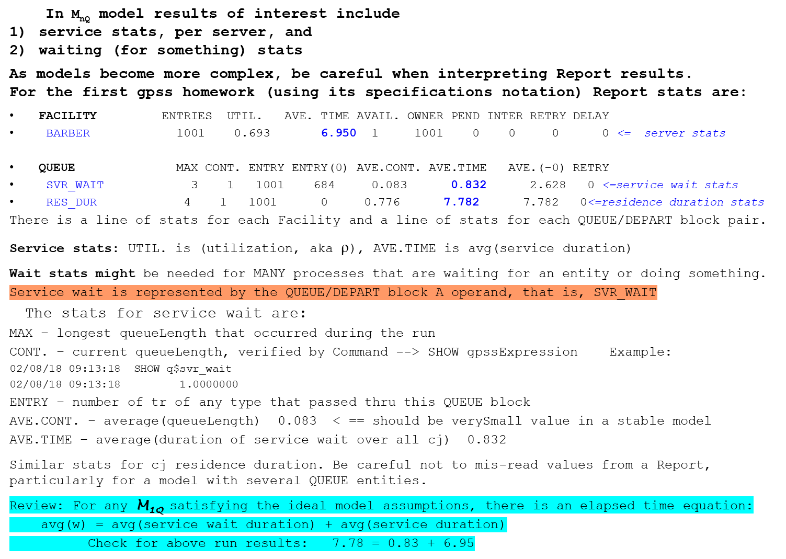
Review – reading stats from a gpssW report

Slide 29
Classification of model types based on execution method
3 model types M_{S}
If S is not Type 1 or 2, then a simulation program(s) for MS must be developed.
Home works for Type 3 focus on simulation capabilities/structure = How to build
We do not emphasize: GUI / graphics / animation (covered in other courses)
Note: computer games are one form of Type 3 simulation that usually emphasizes human
interfacing for sound, visualization, etc.
Classification | Type 1 | Type 2 | Type 3
How it is executed | Carried out by hand; manual calculations | Has exact mathematical solution, or a Sufficiently-accurate approximate mathematical solution | Simulation using executable program(s) in gpss, C++, Java, simpy… or even spreadsheets. { the program(s) is (are) the model implementation }
When to use & Characteristics | Simple model, small number (not millions) of event types | Most preferred. But, most complex models {medical, financial, industrial} are almost never this type | Model is not Type 2 and has a large amount of detail.

Slide 30
Model classifications based on run behaviors
Various M_{S} Classifications
Def – In a continuous model, variables (temperature, pressure, etc.) vary continuously as a function of time
Def – In a discrete model, state value changes occur at discrete times; time is not continuous
Assume discrete system S in rest of course
For a model-specified t.u. value, gpss, and your code can still process fractions of the specified t.u.
However, there is a limit to gpss numeric float precision (six places to right of decimal point)
Def – in closed loop M_{S} , results fed back into M_{S} as it runs = >
feedback affects decisions by the system, thus feedback affects execution
Example: space heating S; sensor monitors temperature as heater runs until temperature v is reached;
WHEN room temperature > v, THEN shut off heater fan.
The feedback is current room temperature
Def – in open loop, M_{S} runs a pre-determined amount of model time OR until some event occurrence or pre-defined condition; few, if any, runtime results are fed back into the model;
events are based only on current model state and the model’s logic (no explicit feedback)
Assume, unless noted, open loop for systems S in this course
Example: when a modern car/truck is started, there is little sensor feedback available
(from electrical and mechanical subsystems) during the starting process; startup is thus,
operationally, open loop based. Explains why ‘no start’ is difficult to diagnose.
{ For ICEs, (Internal combustion engines) some sensor feedback occurs during startup, such as
crankshaft position sensor output voltage sent to Ignition control module as a signal to produce spark;
therefore, auto/truck ICE subsystems operate in open loop @startup and then closed loop for the rest
of a drive cycle; in this phase, the glut of sensors on modern vehicles generates much feedback }

Slide 31
Model classifications, cont’d
Def – in static M_{S} each event is unaffected by previous events
Example: (Assuming a “fair” coin) the outcome of each coin toss is not affected by any previous toss(es)
Def – in dynamic M_{S} events affect other events/states
Example: the {ia} distribution can affect fluctuations in service queueLength
Example: In a computer network, individual packet transmission time from a source to a destination depends on many interacting factors:
* the (variable) amount of competing packet traffic
* how packets are processed/served at switches
* server interconnectivity (topology) and connection capacity
* failures (connection refusals, lost packets, etc.) that cause unpredictable
routing delays, recovery processing, etc.
= => Simulations in CSC148 are: 1) discrete 2) open loop, and 3) dynamic models

Slide 32
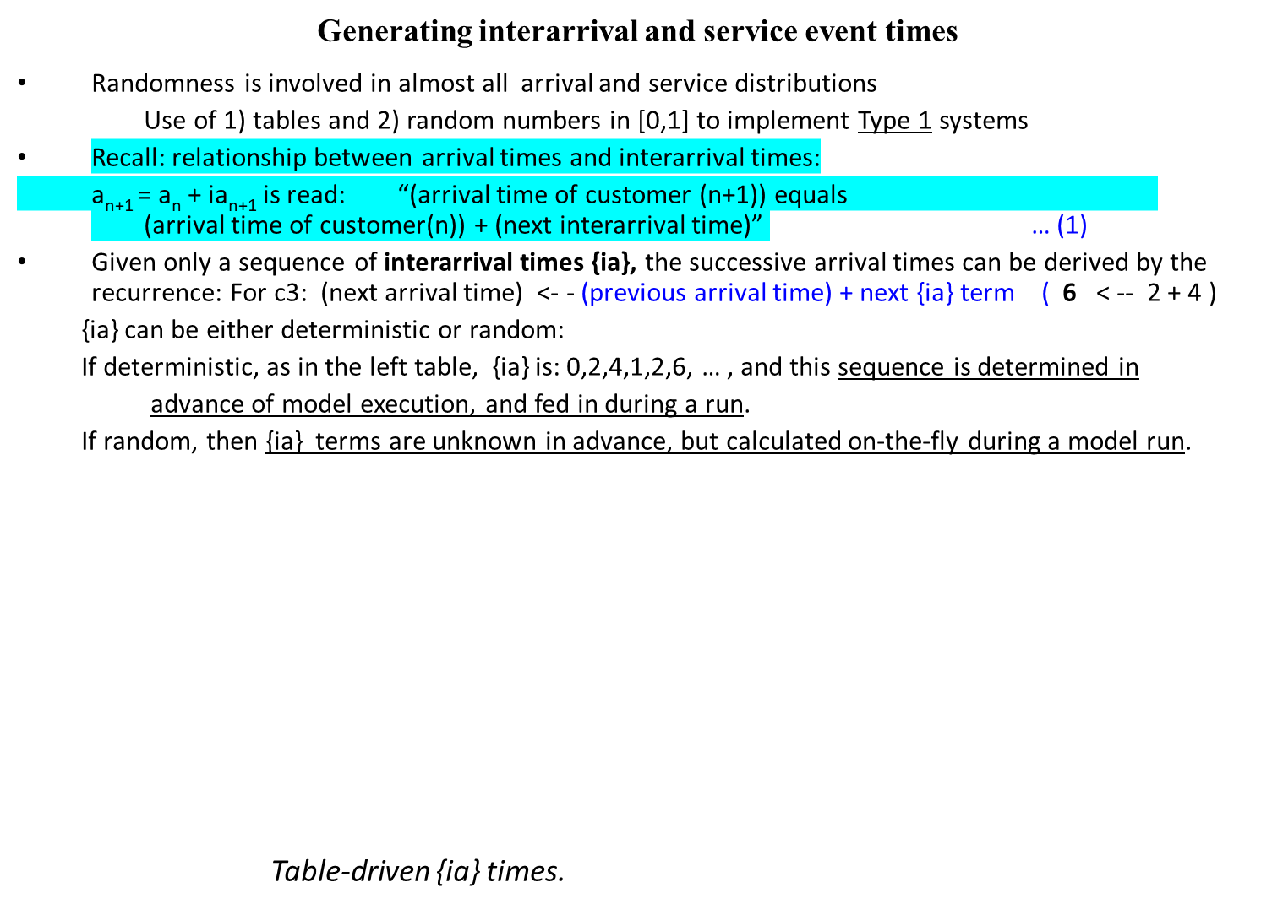
Randomness involving various distributions
Customer | interarrival time | Arrival time
1 | - | 0
2 | 2 | 2
3 | 4 | 6
4 | 1 | 7
5 | 2 | 9
6 | 6 | 15
Customer | Service time
1 | 2
2 | 1
3 | 3
4 | 2
5 | 1
6 | 4

Slide 33
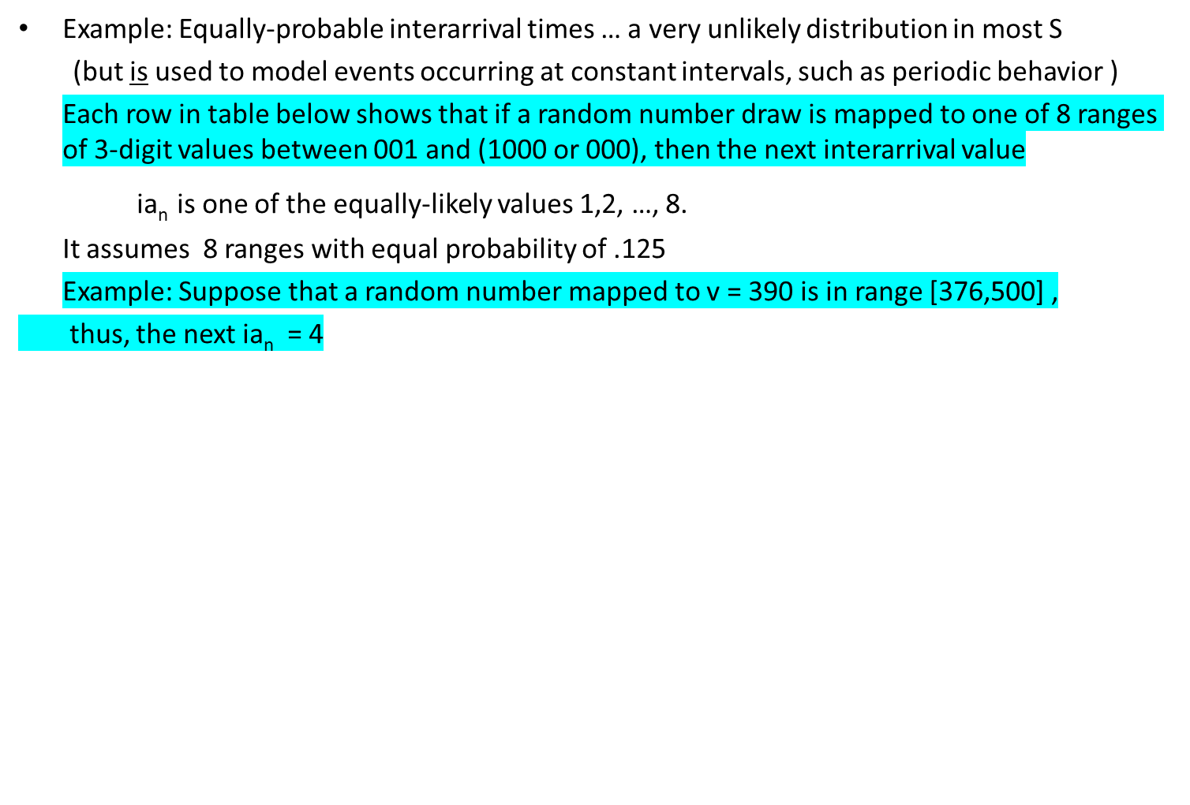
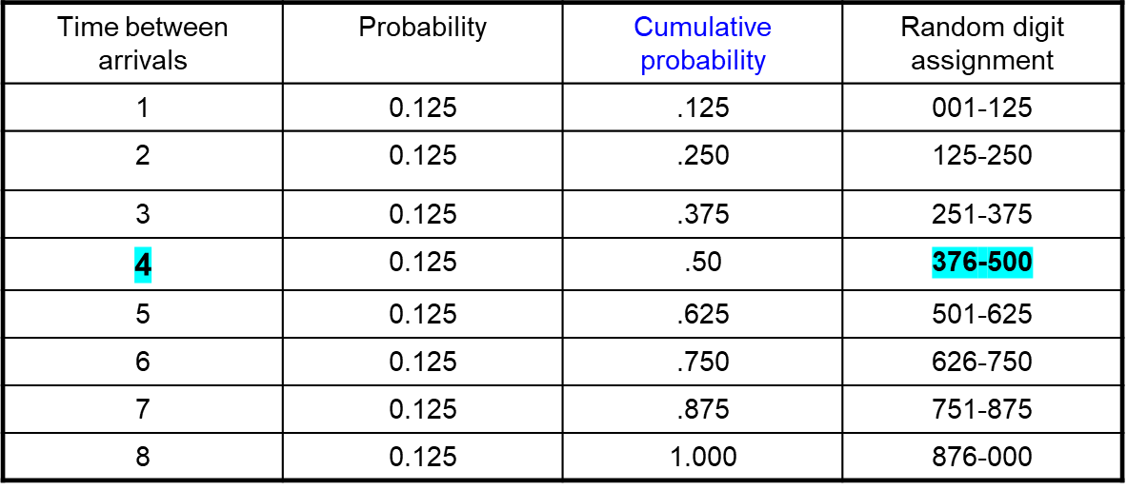
Randomness for an equi-probable (aka uniform) distribution with finitely-many values

Slide 34
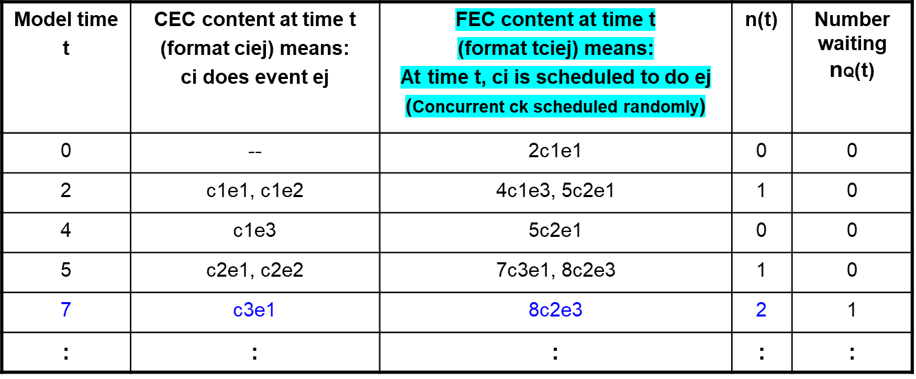
Tracing CEC & FEC, and state transitions in M_{1Q} model
Simple tabular notation can be used for event scheduling and execution.
Revisit Figure: n(t) vs. t step function on a previous slide.
Using that scenario of arrivals and services, the following table is a trace of the events and their time of occurrence, and corresponding model state information.
Event types: e1: a cj arrival e2: a cj starts service e3: a cj finishes service and leaves S
At t = 7 is the first time a customer waits. Consider the instant just after c3 has arrived.
c2 is being served (in gpssW code, c2 is “in” its ADVANCE block, and c3 is waiting because it was refused entry into the SEIZE block).
This is how the concurrent service and waiting for service are simulated

Slide 35
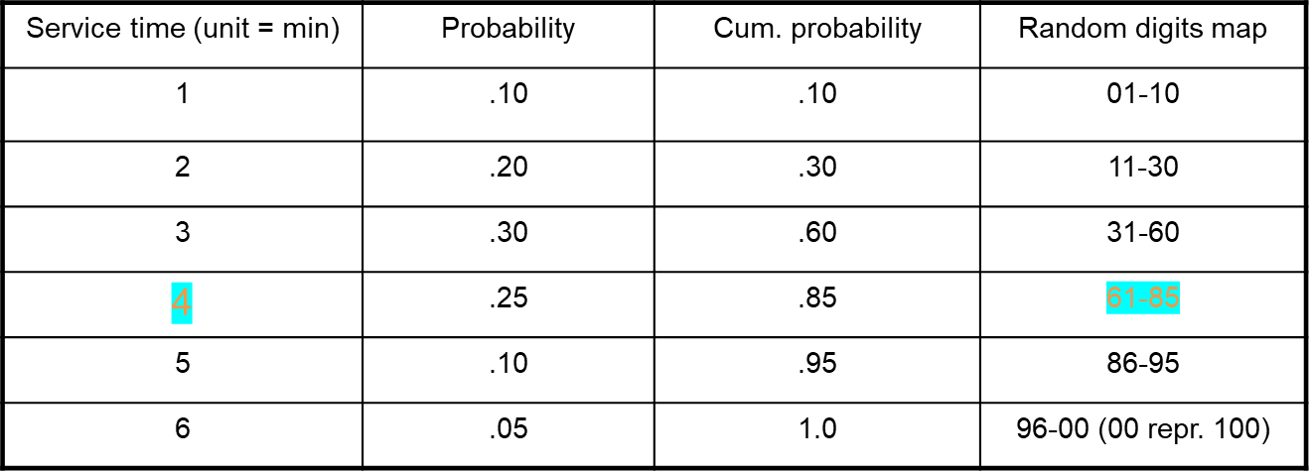
Randomness for an empirical distribution
Example: An Empirical distribution of the t(s), that is, customer service times, follows a peculiar distribution for the particular application, and the distribution NOT any well-known one (such as: exponential, constant, uniform, normal, Poisson, triangular, etc.)
Concerning the column “Random digits map”, for 0 < random# r < 1, map r to its value in the range 1 to 100. The Random digits draw ranges/weights have proportional probabilities.
Example: If r is .617, then the corresponding draw range value is r * 100 = 61.7,
thus, the corresponding “Service time (unit=minutes)” duration is 4 minutes
Note that a service distribution might be empirical because specific industries or processes have very specific services with special-case processing.

Slide 36
Event notices and the Event List
Event notice – a data structure representing an event:
it must contain all info the simulator needs to process the event
CEC and FEC (gpss terminology) is the most fundamental data structure in a DES
They form the data source for all event representation and event scheduling.
FEC is often described/defined/discussed as a list, but this is generic terminology:
each DES implementation chooses/uses its specific structure.
Physically, the structure might not be a “list”: (could be a hash table, a heap, etc.)
FEL content (conceptual): |t1, event1| - - > |t2, event2| - - >
where t1 <= t2 <= … and tk is the model time when eventk will occur.
List item format is more complex in a typical DES engine
For example, events can be prioritized (thus each FEL item has a priority value)
Prioritization can be used to (partially) order all events that occur at time tf
FEL operations
Insert an event at the appropriate future time
Remove first event for processing at current time
Delete/cancel/re-prioritize/re-position a scheduled future event
In more complex simulations, change an event’s FEL position (based on particular simulation state changes and events)

Slide 37
Main loop of a DES runtime
Processing components of any discrete-event simulation include:
> Defining termination conditions
> Model run initializations
> Generation of future events
> Processing the next event at the current time
From an “event-processing” viewpoint, a simulation executes as follows:
  > Initialize the runtime; do all events at time 0 (if any)
> Advance clock to min. future time “x” having > 0 events posted
> Process all of events posted at time x on CEC; post items on FEC, as needed, including GENs;
gather statistics for current time x
> IF (run Not Finished) { branch back }
{ Terminate run and do post-run processing and Reporting }
current time
Note 1: With gpss studied so far, only GENERATE and ADVANCE can schedule future events
Note 2: One of the most complicated aspects of a simulation run-time system is state and state change representation for events. When reading block docs, note the effects on CEC/FEC.
If no such time x exists, Halt simulation
0 CEC: ex1, … exn y1 y2 FEC = {yi} t

Slide 38
Some properties of discrete event simulator engines
We cover only one common discrete model paradigm in this course,
namely, stochastic (means: randomly-determined) discrete event simulators.
Continuous simulation state evolution is done with difference equation approximations to differential equations (fluid flowing through a pipe, windsheer effect during aircraft takeoff, etc.).
Discrete simulation state evolution is different because state variables take on only discrete (possibly fractional) values; time is incremented only to times during which events happen.
In other words, if tc is current model time, and all events scheduled for time tc have been processed, then the simulator automatically advances time to tmf = (the smallest future time having at least one item on the FEC)
Properties/Operating Rules of stochastic discrete event simulators (as is gpss)
State variables take on only discrete values
Time can increment over varying increments (possibly avoid doing MANY clock ticks)
All state variable values remain unchanged during intervals in which time advances in a single step (regardless of the step size)
No time elapses when making state changes – regarding gpss, a tr “x” that enters block “B” changes x’s state, and thus the model state (Report ‘ENTRY COUNT’ records entry into B). There is no model time used by a tr to enter B (assuming no Refuse Mode or refuse delay done) .
Time advances only because events occur and/or state changes
Review:
Stochastic simulators use distributions to produce random values for model use on-the-fly Deterministic simulator event times (such as {ia} values) are known before execution

